Slide 1
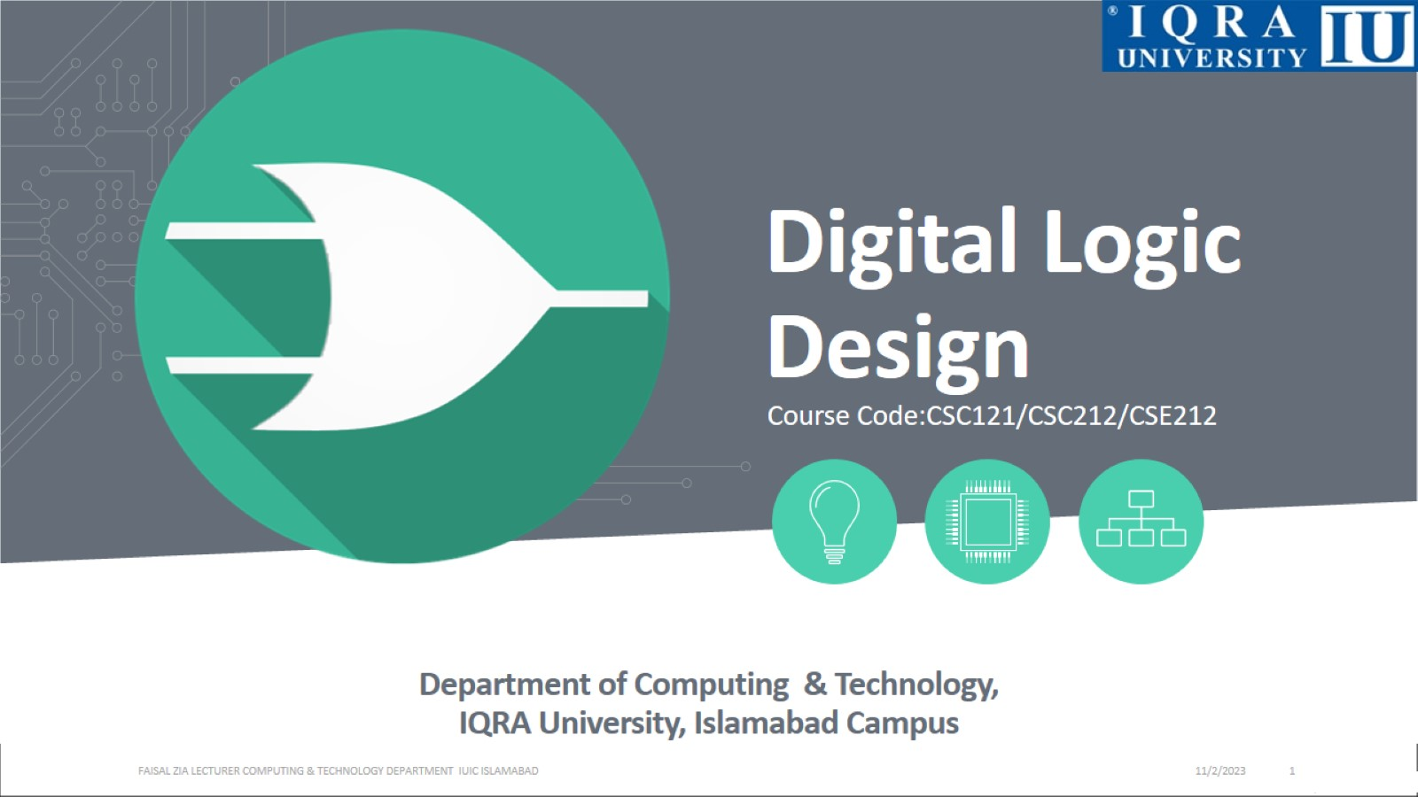
Digital Logic Design

Slide 2
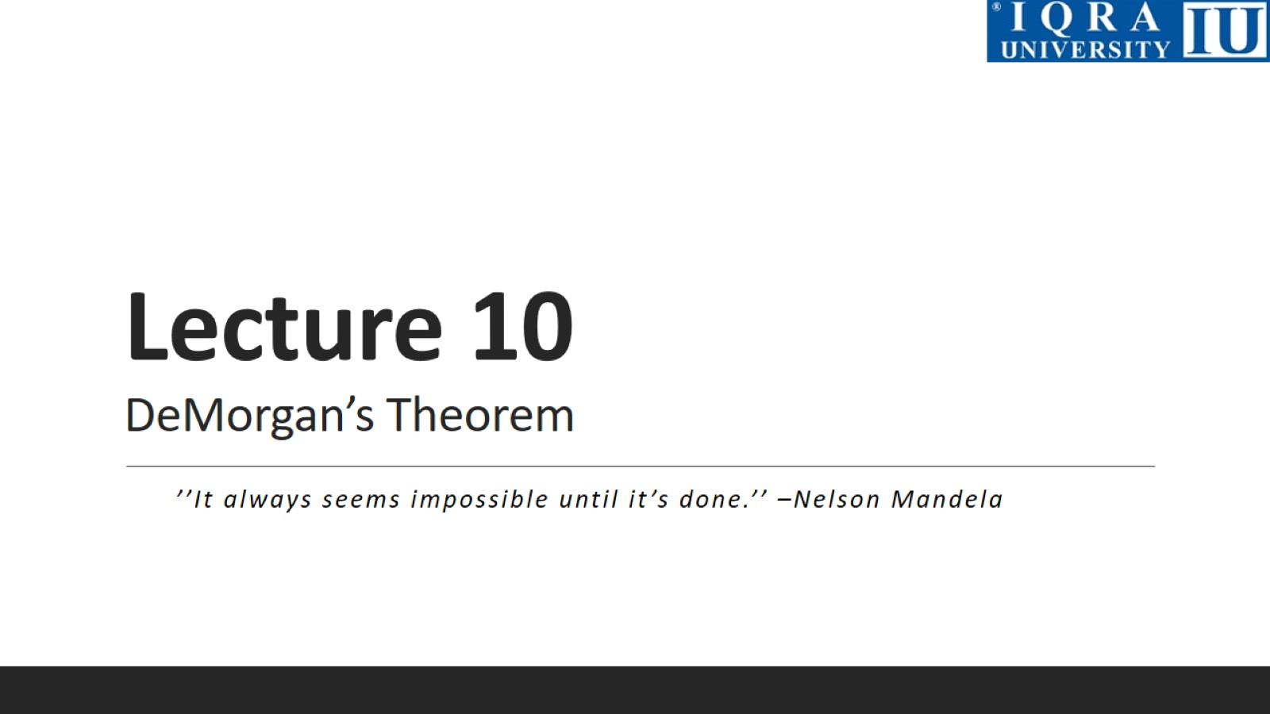
Lecture 10 DeMorgan’s Theorem

Slide 3
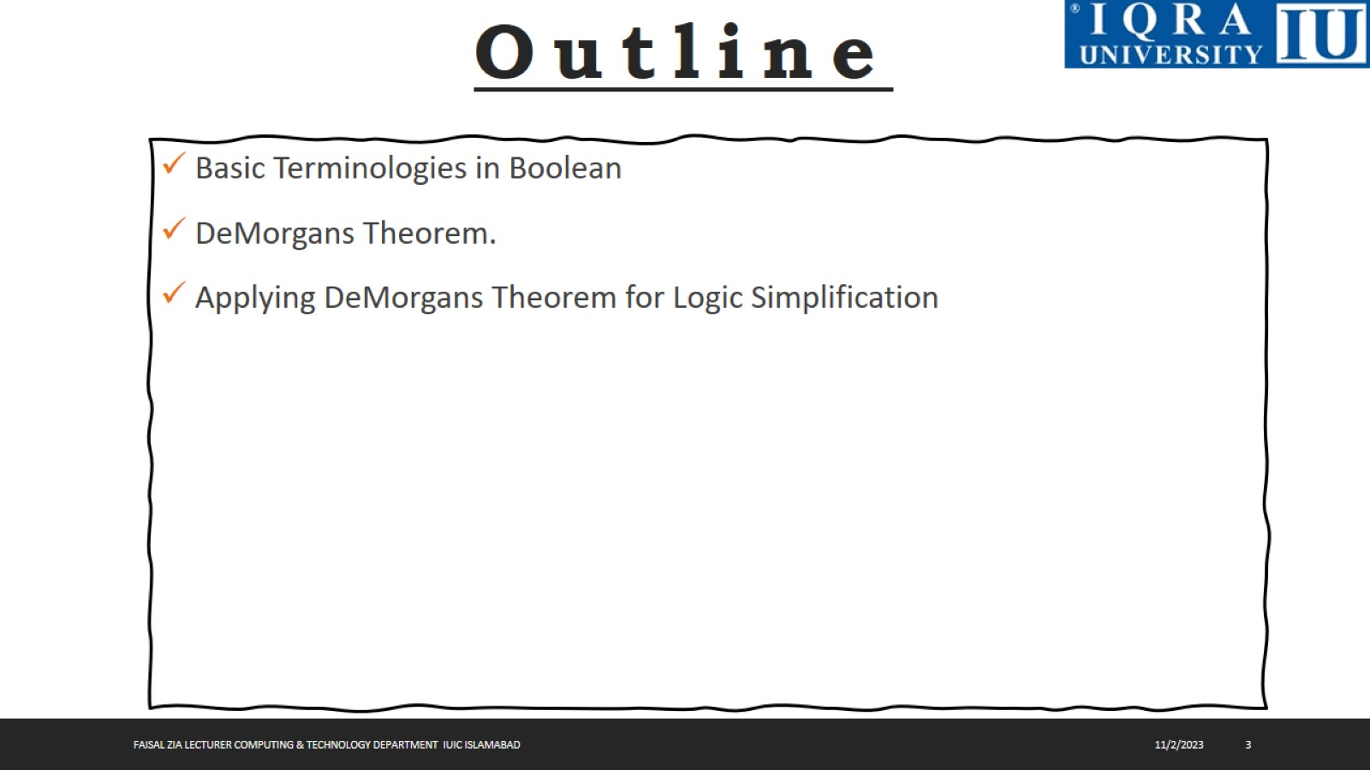

Slide 4
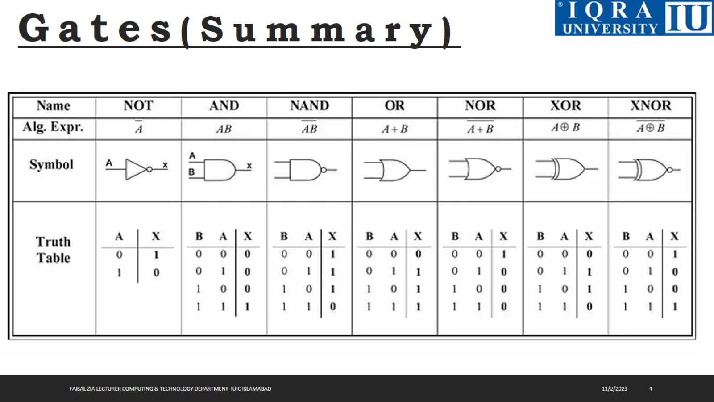

Slide 5
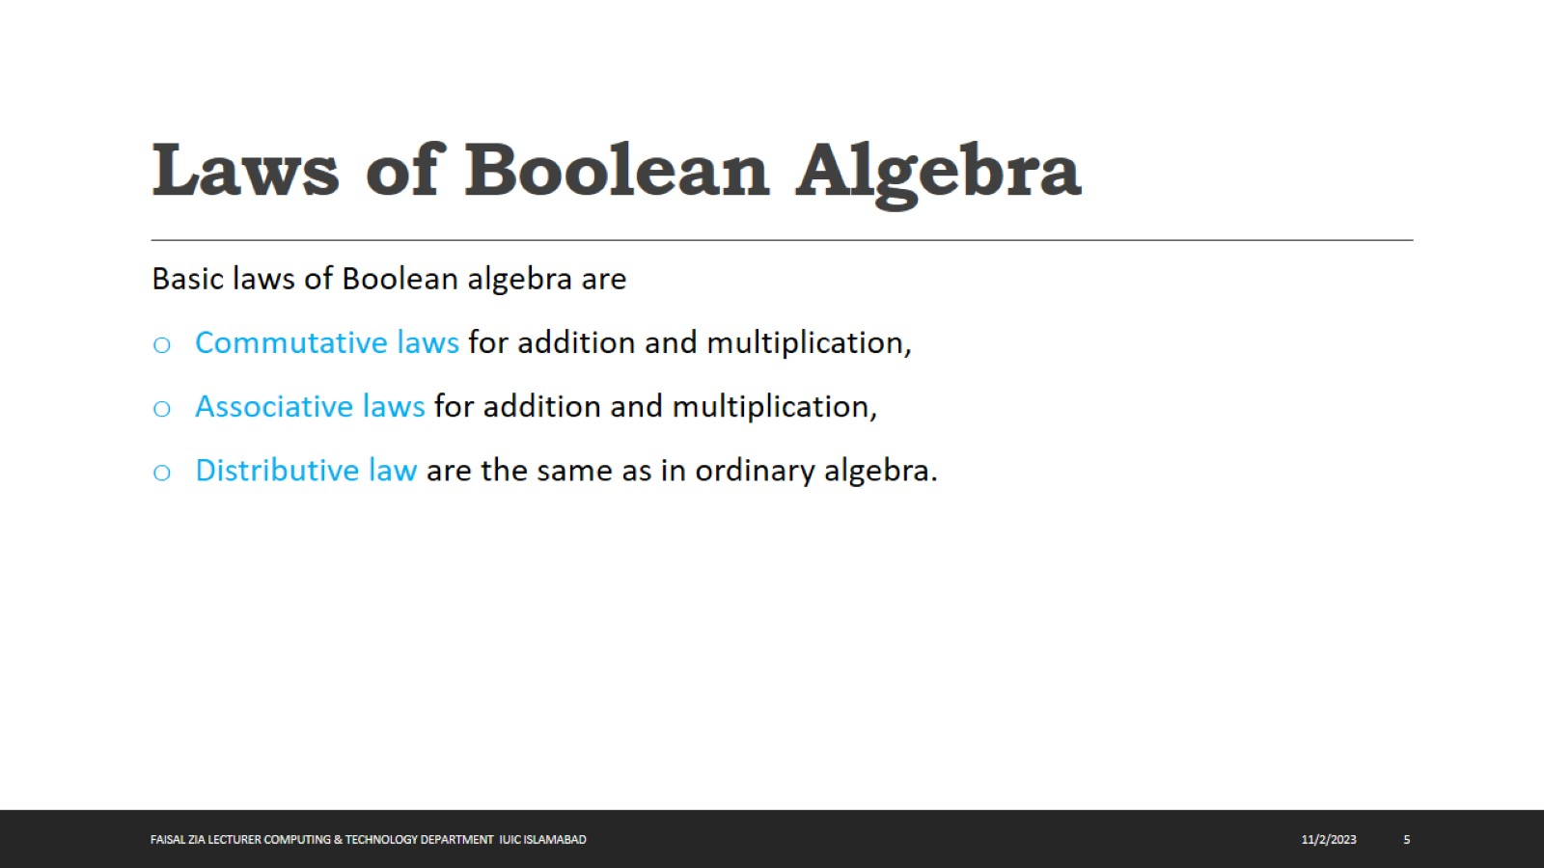
Laws of Boolean Algebra

Slide 6
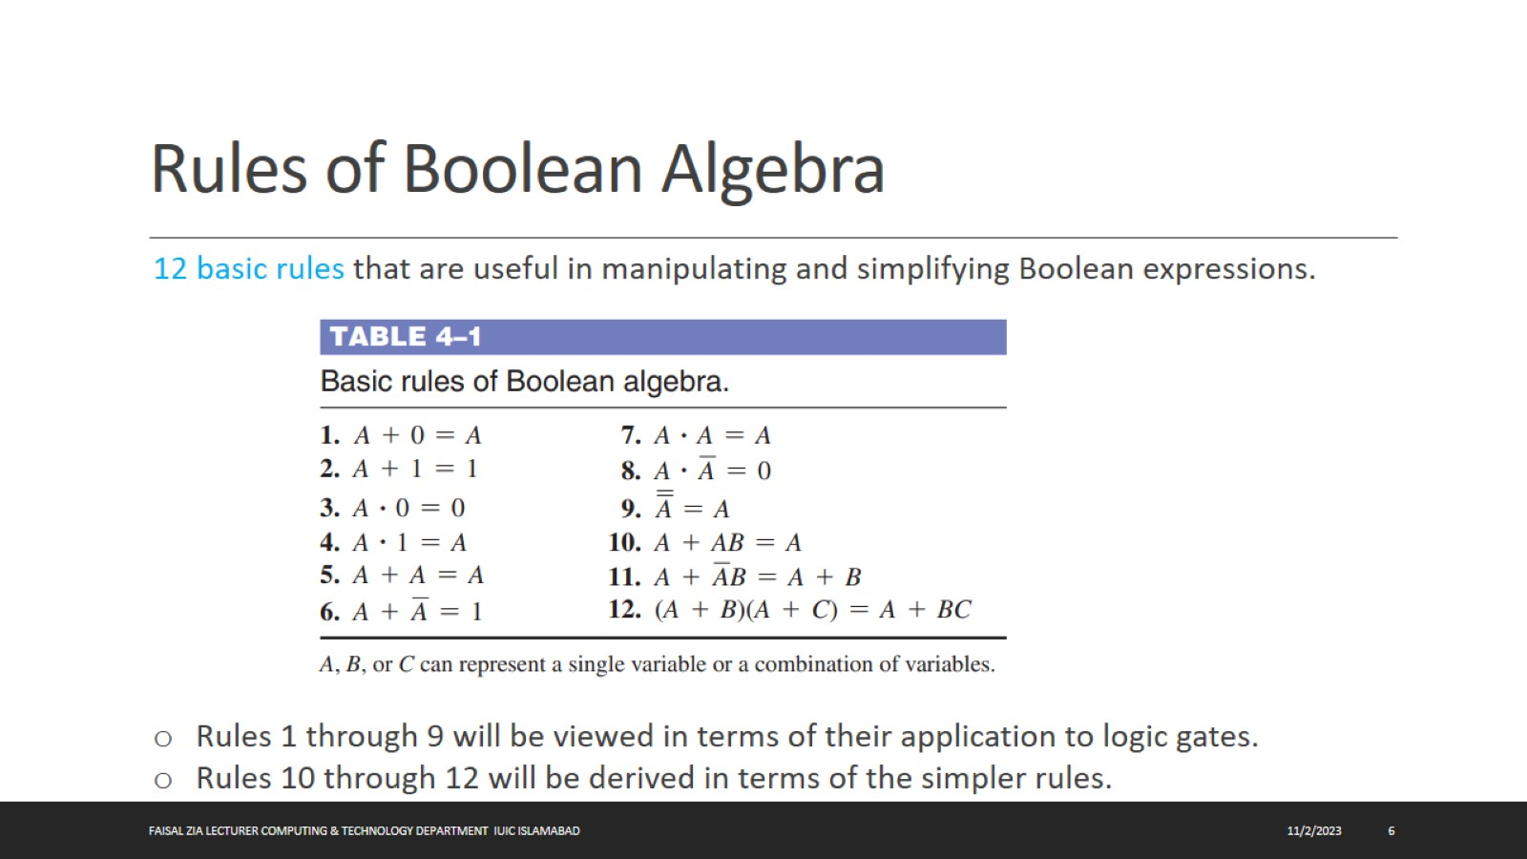
Rules of Boolean Algebra

Slide 7
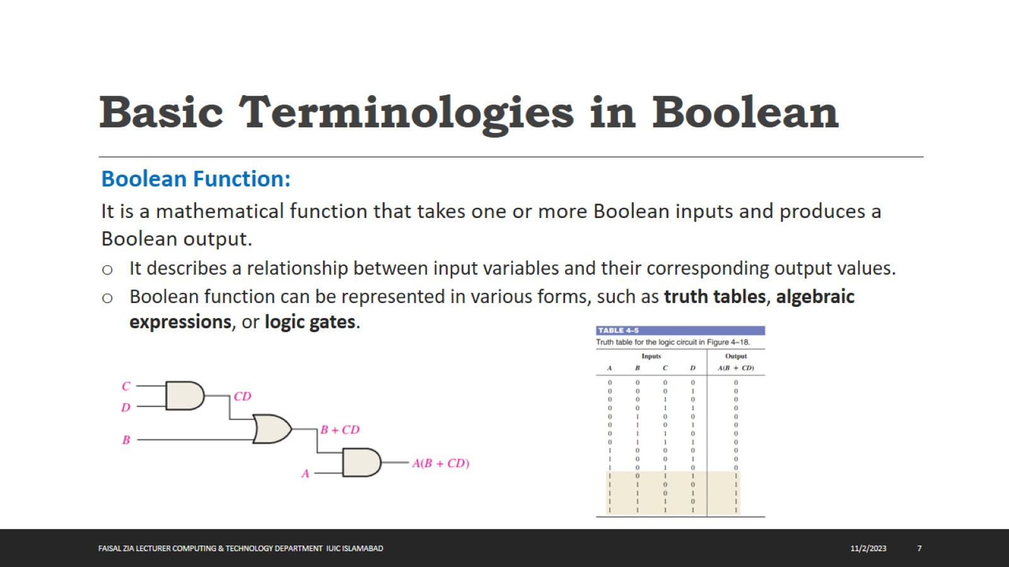
Basic Terminologies in Boolean

Slide 8
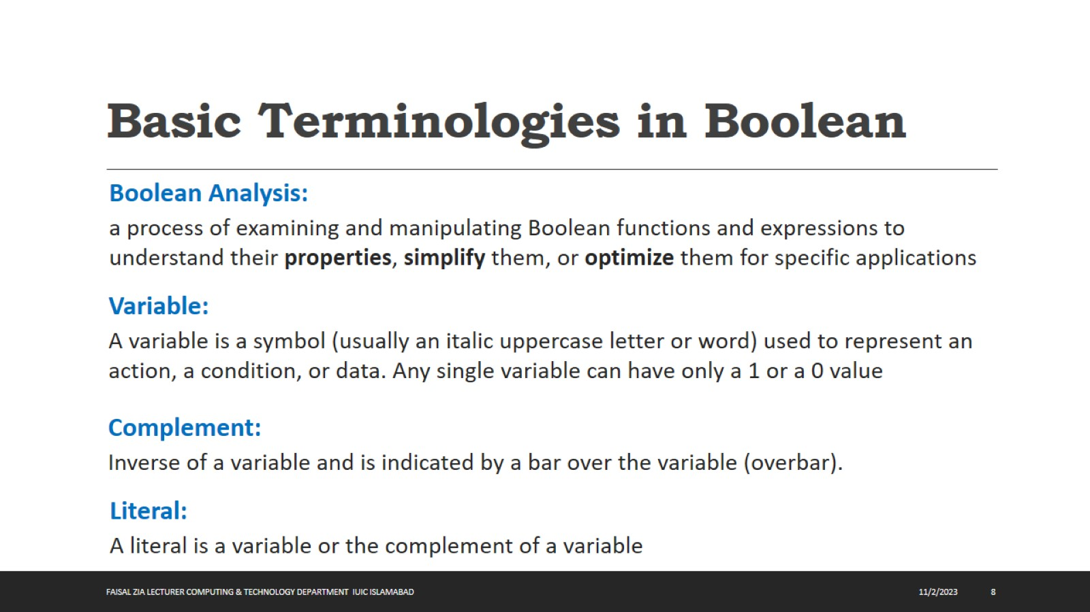
Basic Terminologies in Boolean

Slide 9
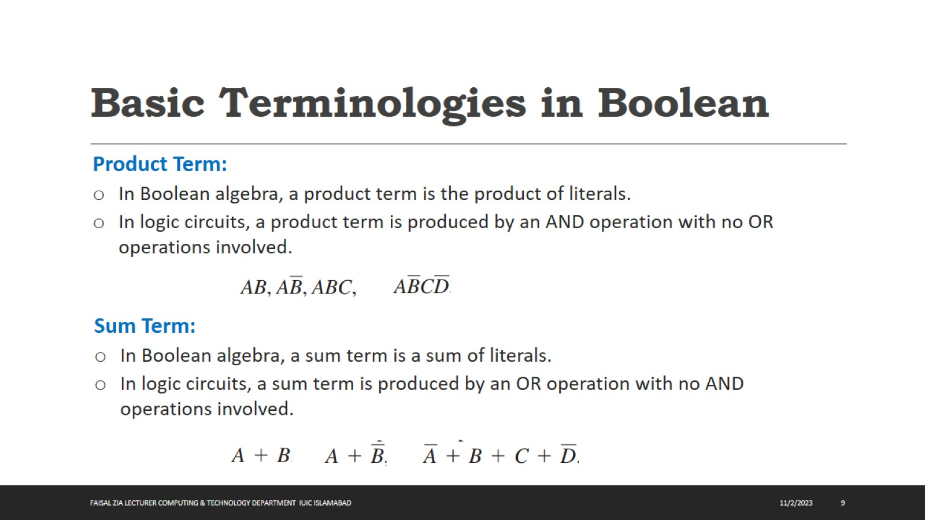
Basic Terminologies in Boolean

Slide 10
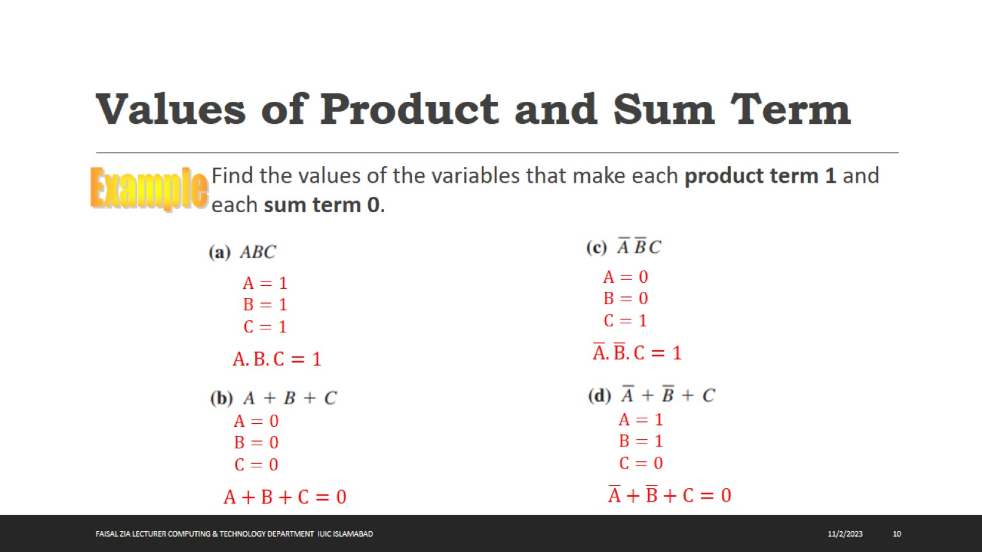
Values of Product and Sum Term

Slide 11
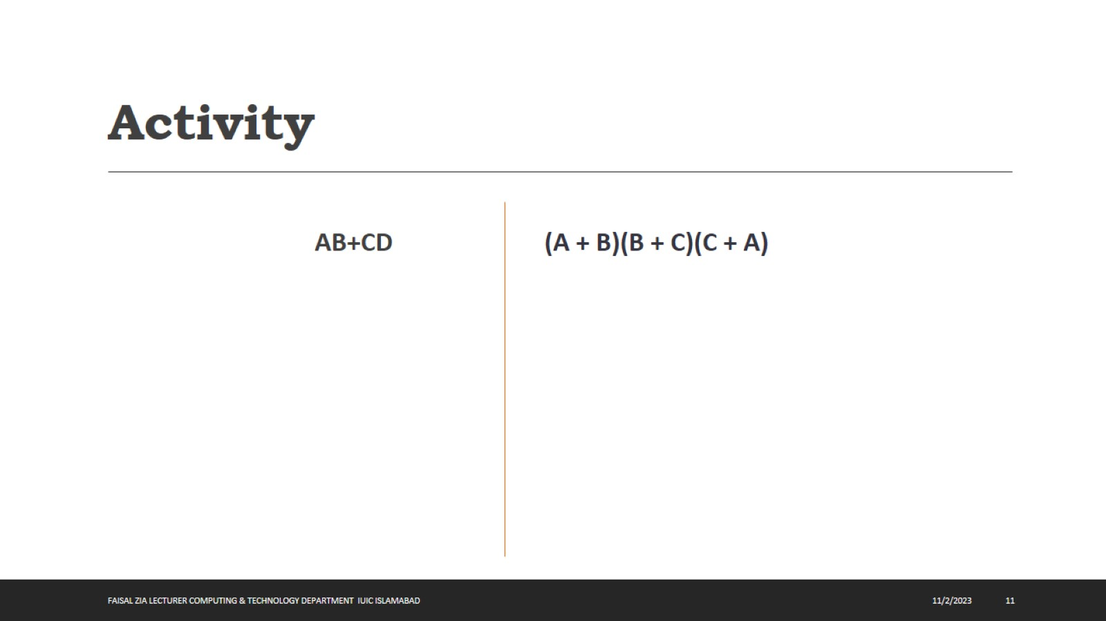
Activity

Slide 12
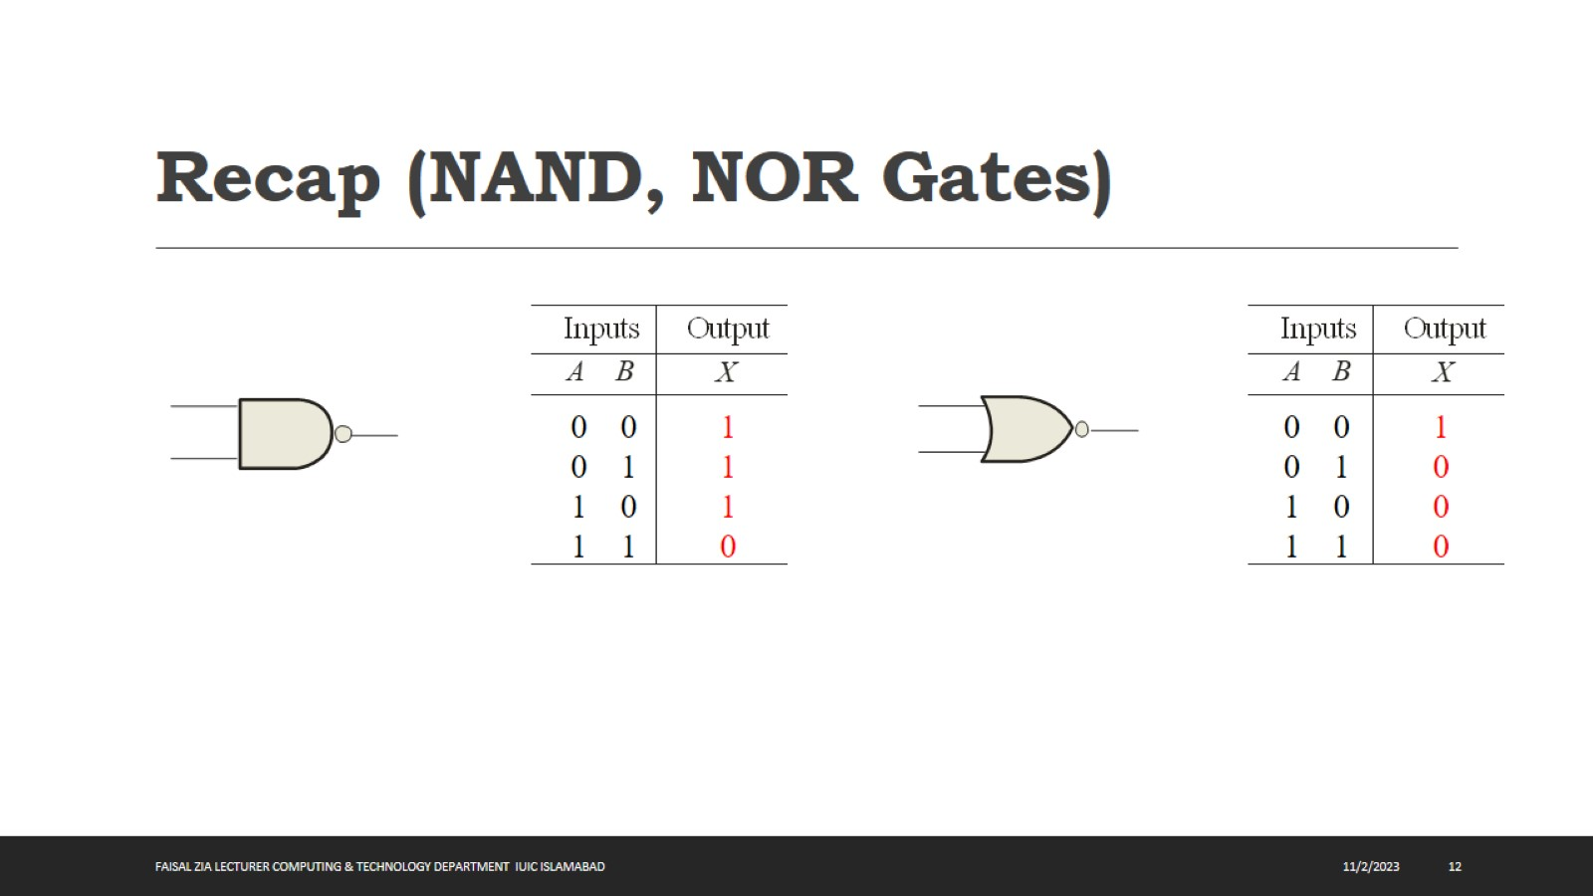
Recap (NAND, NOR Gates)

Slide 13
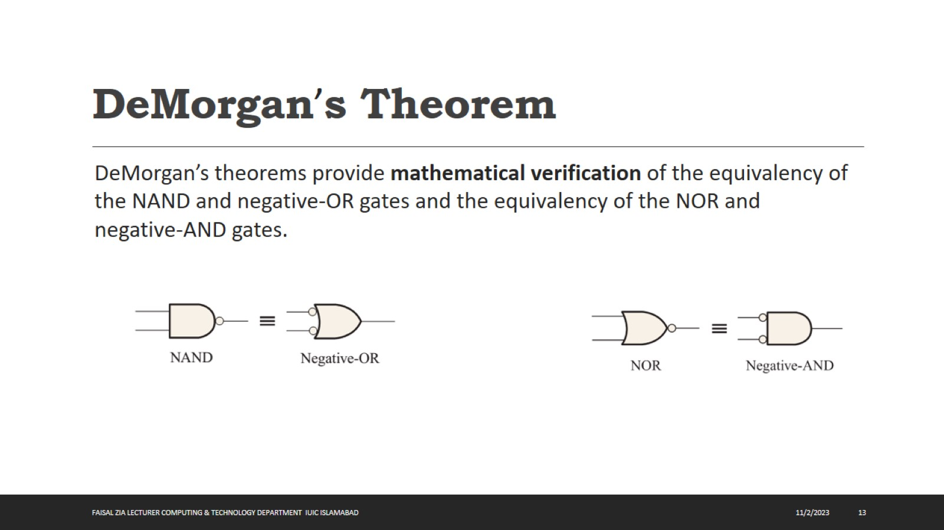
DeMorgan’s Theorem

Slide 14
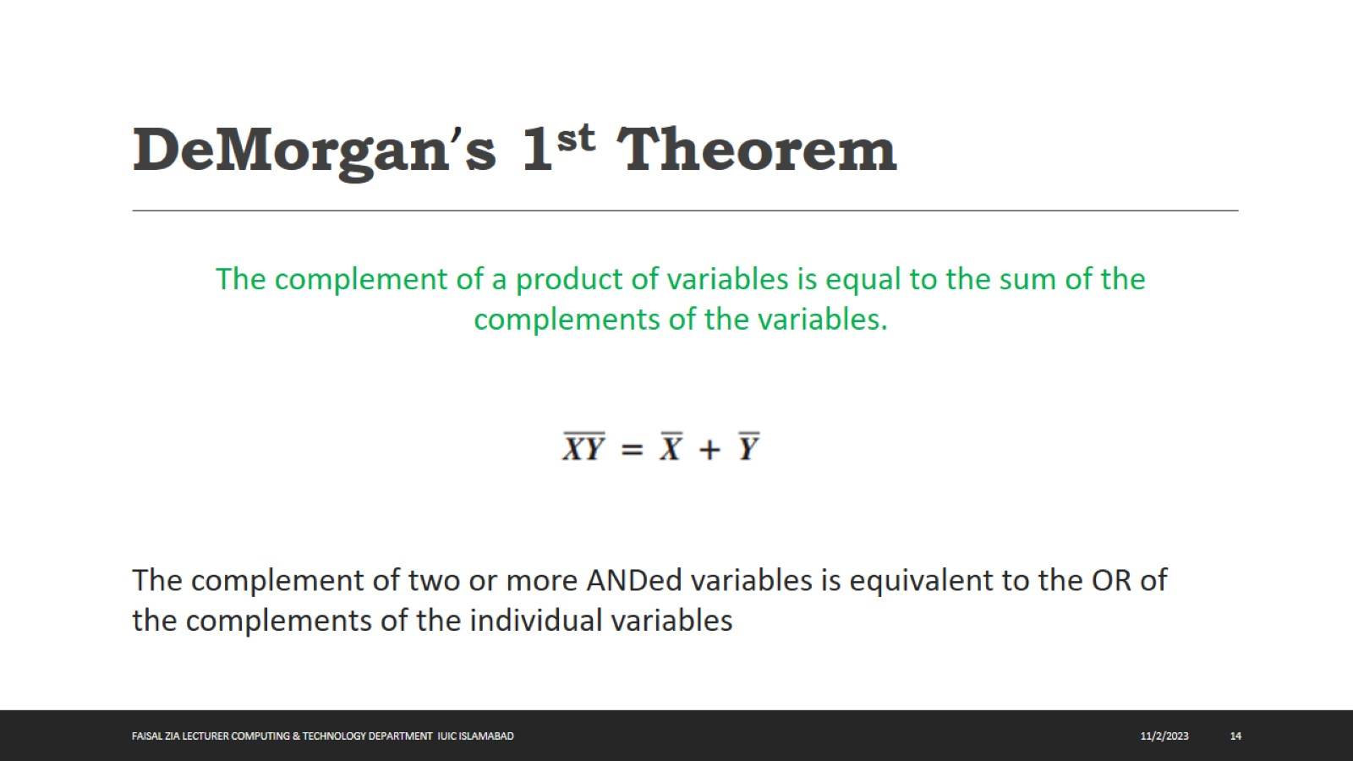
DeMorgan’s 1st Theorem

Slide 15
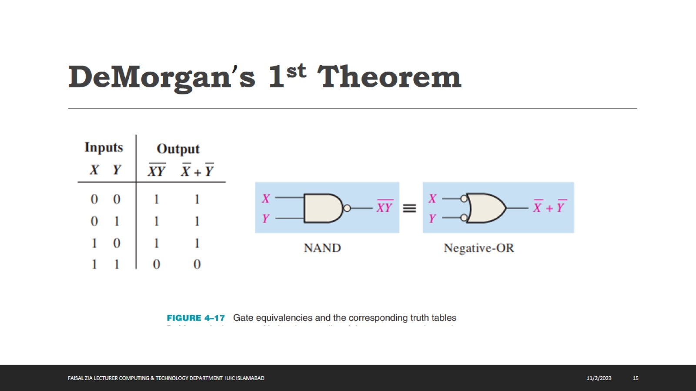
DeMorgan’s 1st Theorem

Slide 16
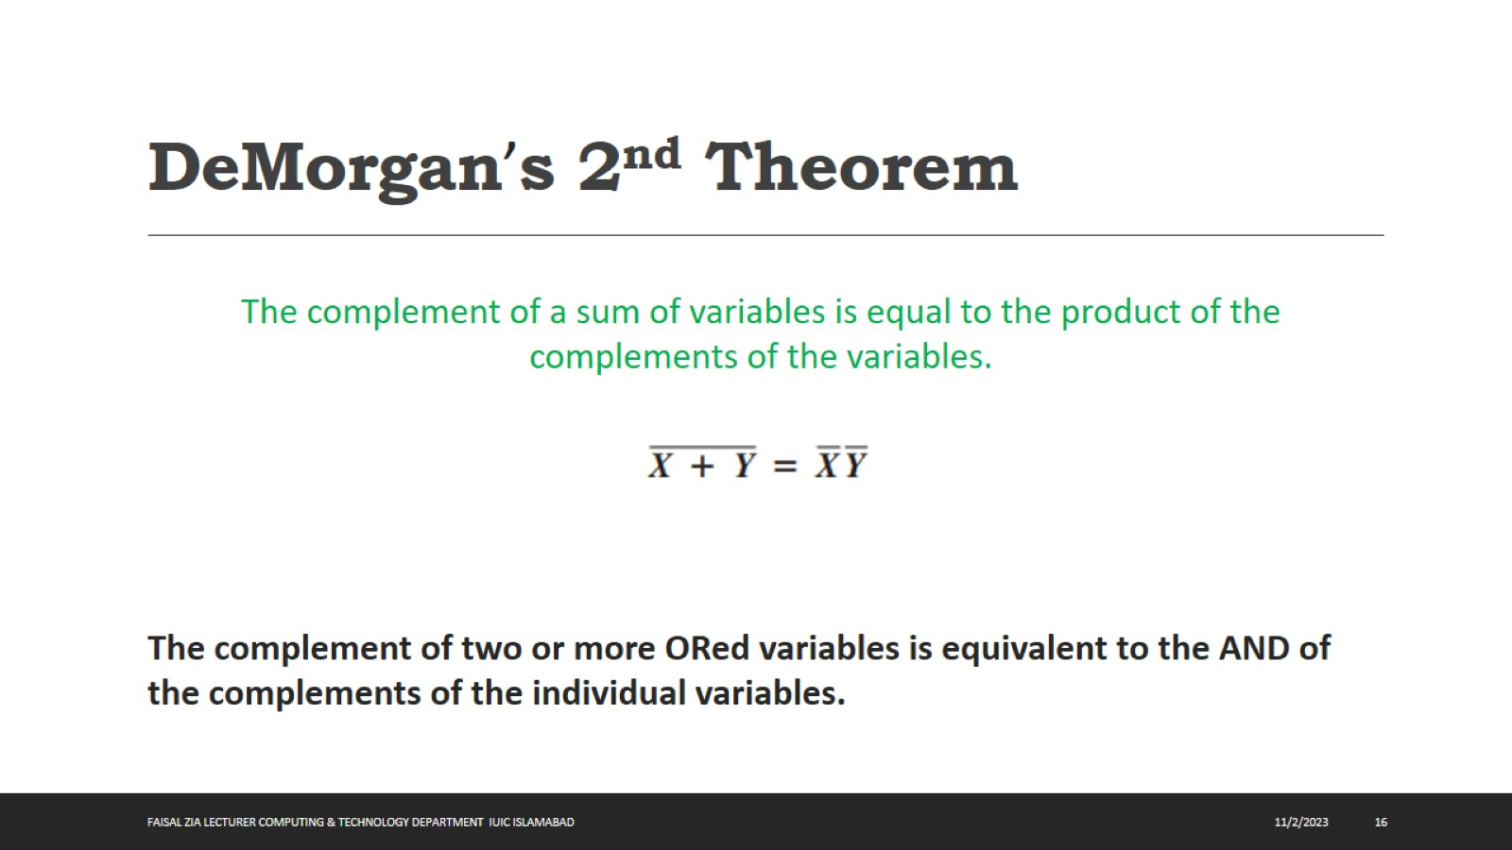
DeMorgan’s 2nd Theorem

Slide 17
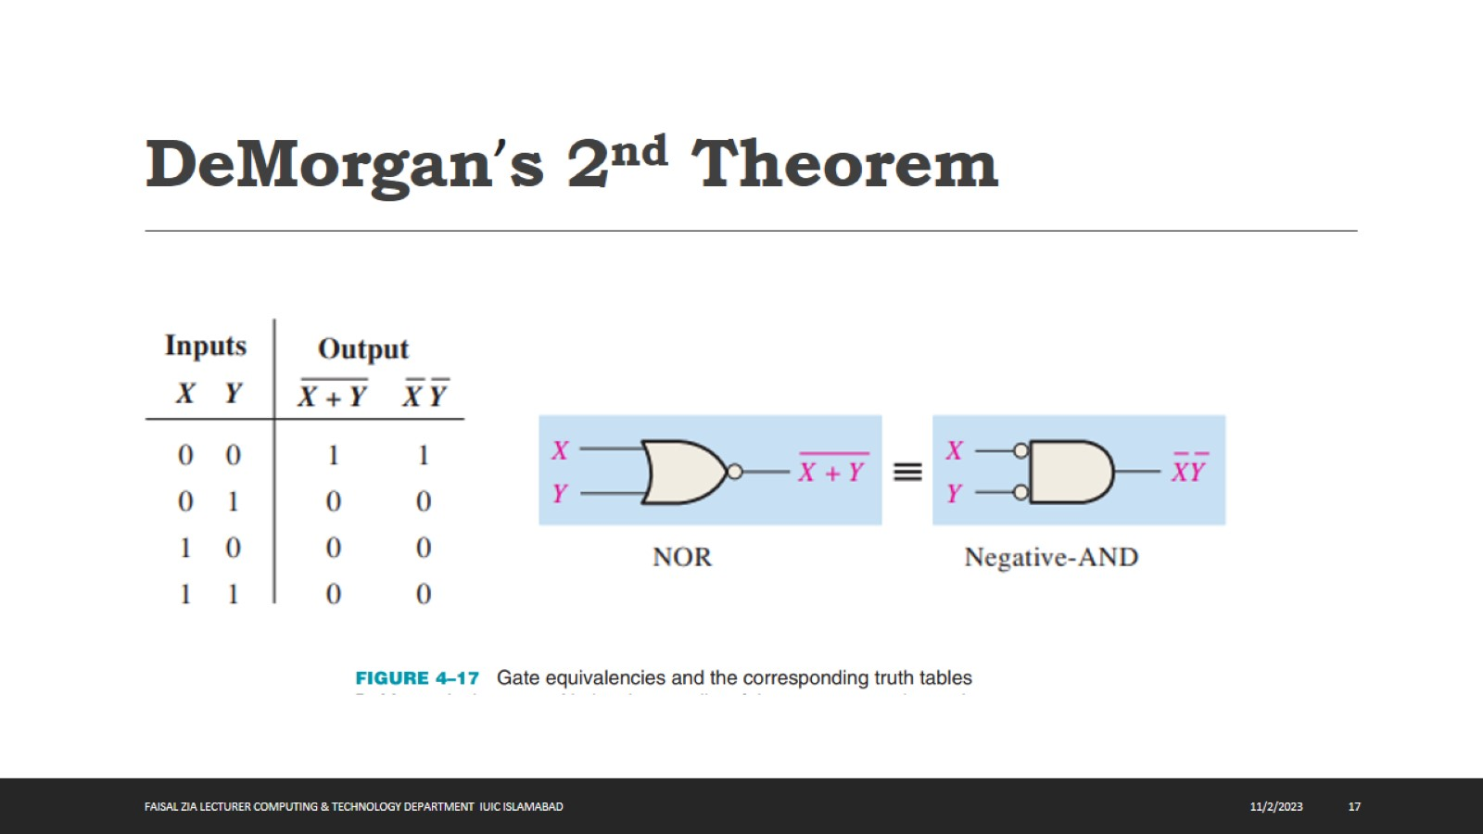
DeMorgan’s 2nd Theorem

Slide 18
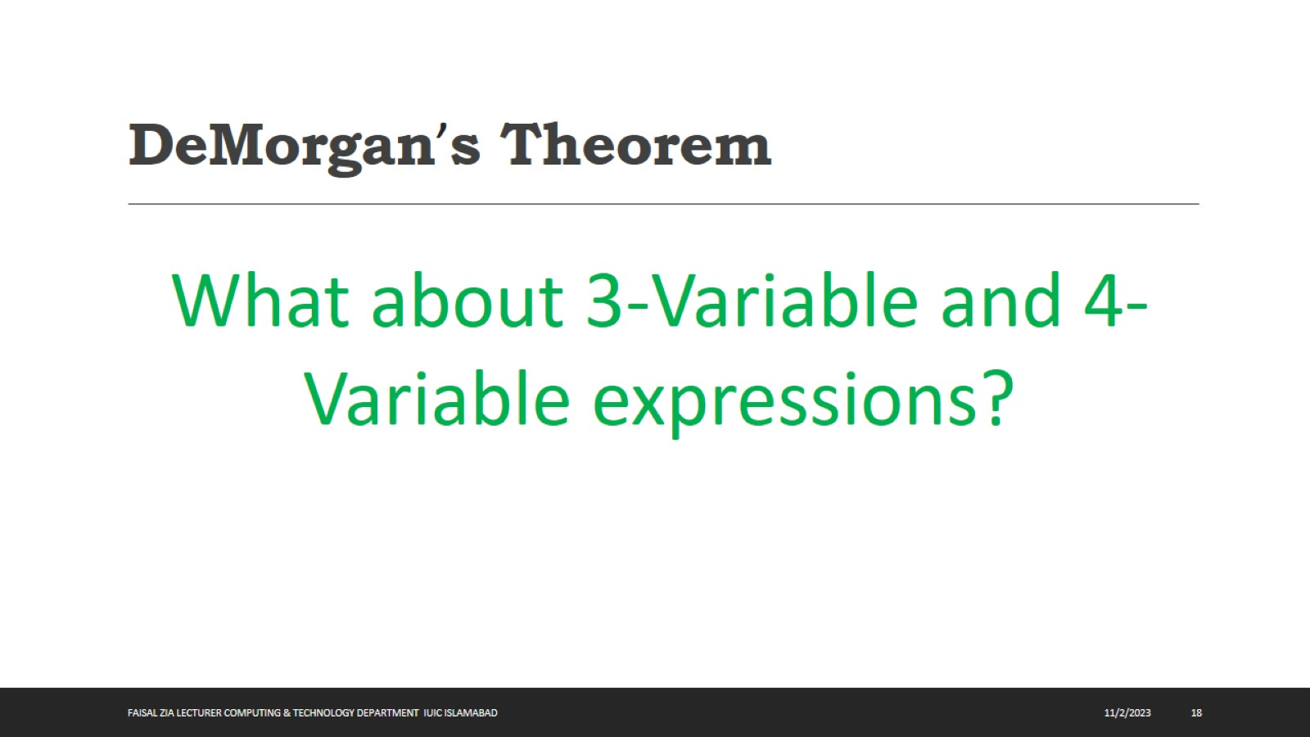
DeMorgan’s Theorem

Slide 19
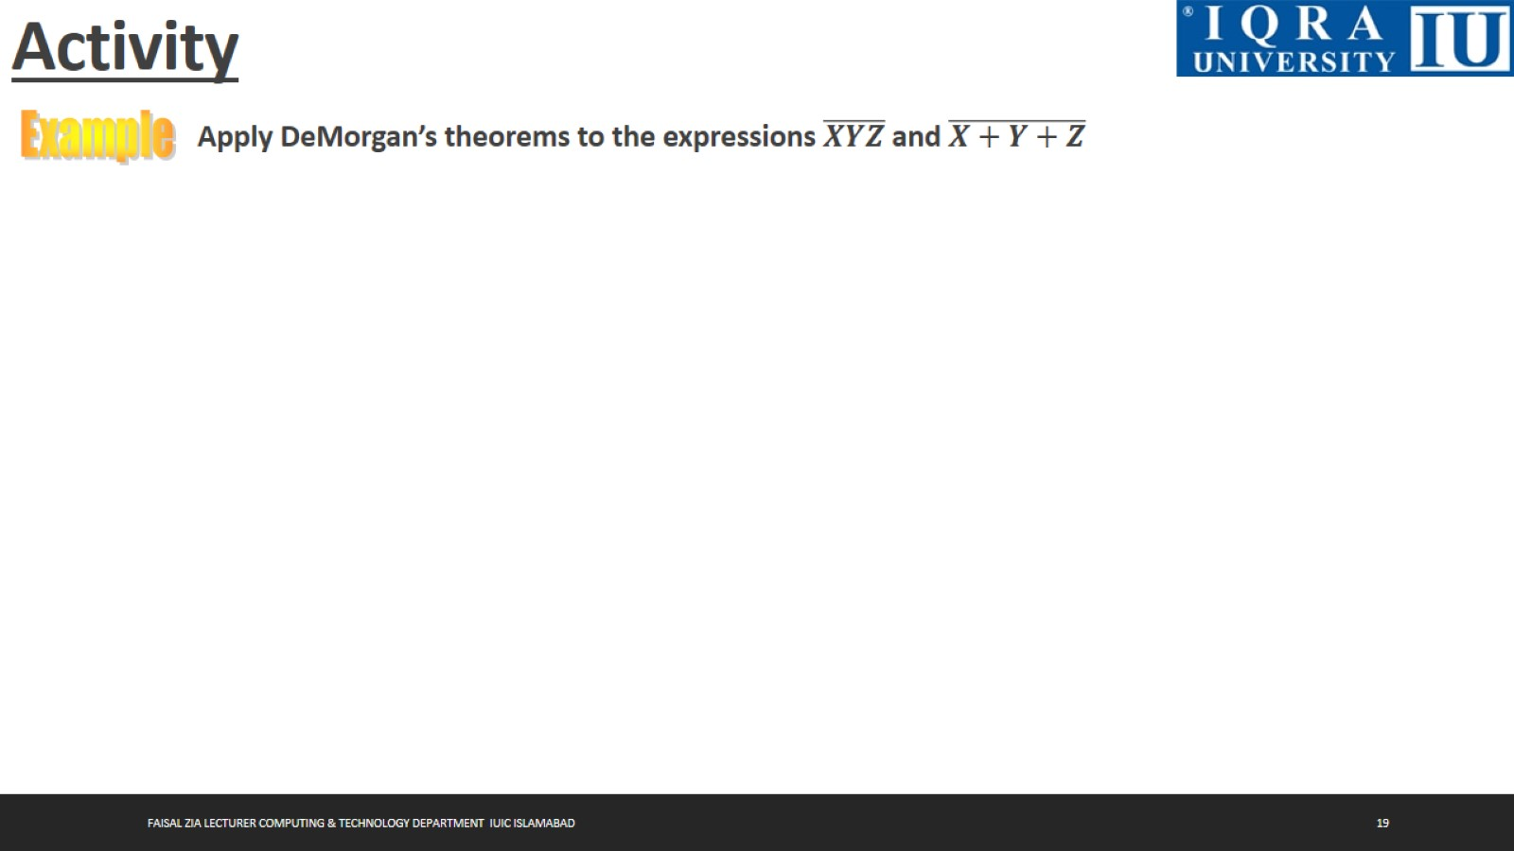
Activity

Slide 20
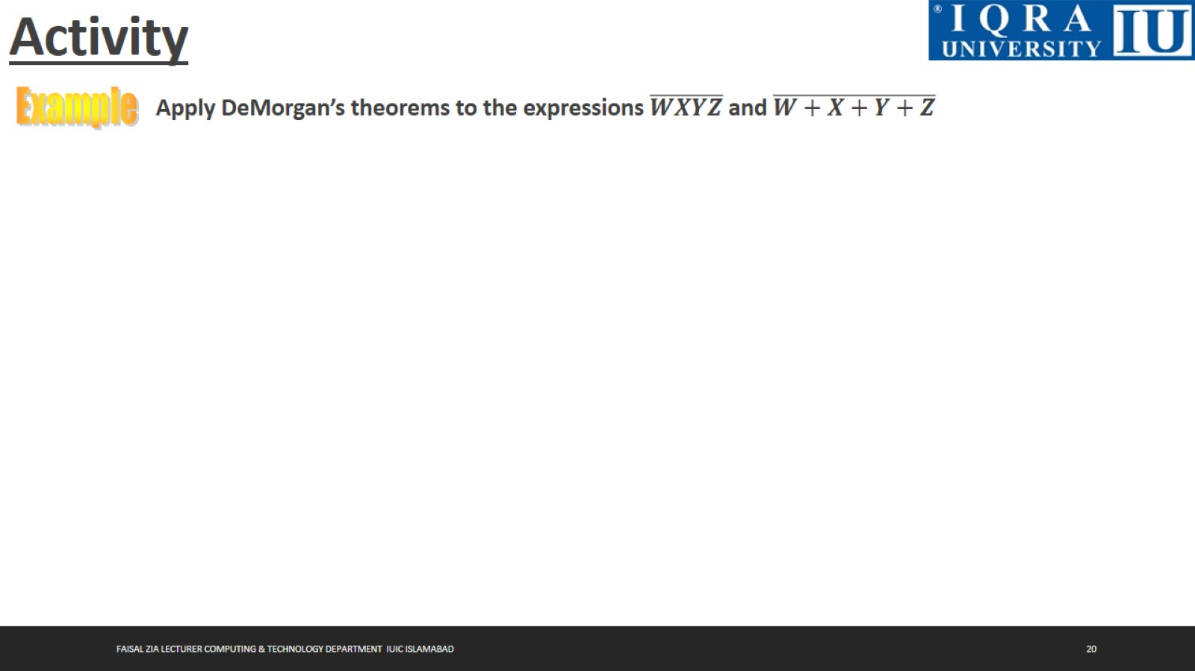
Activity

Slide 21
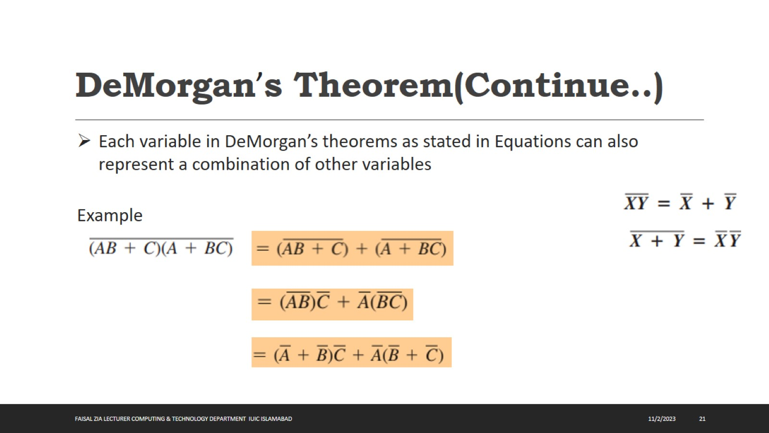
DeMorgan’s Theorem(Continue..)

Slide 22
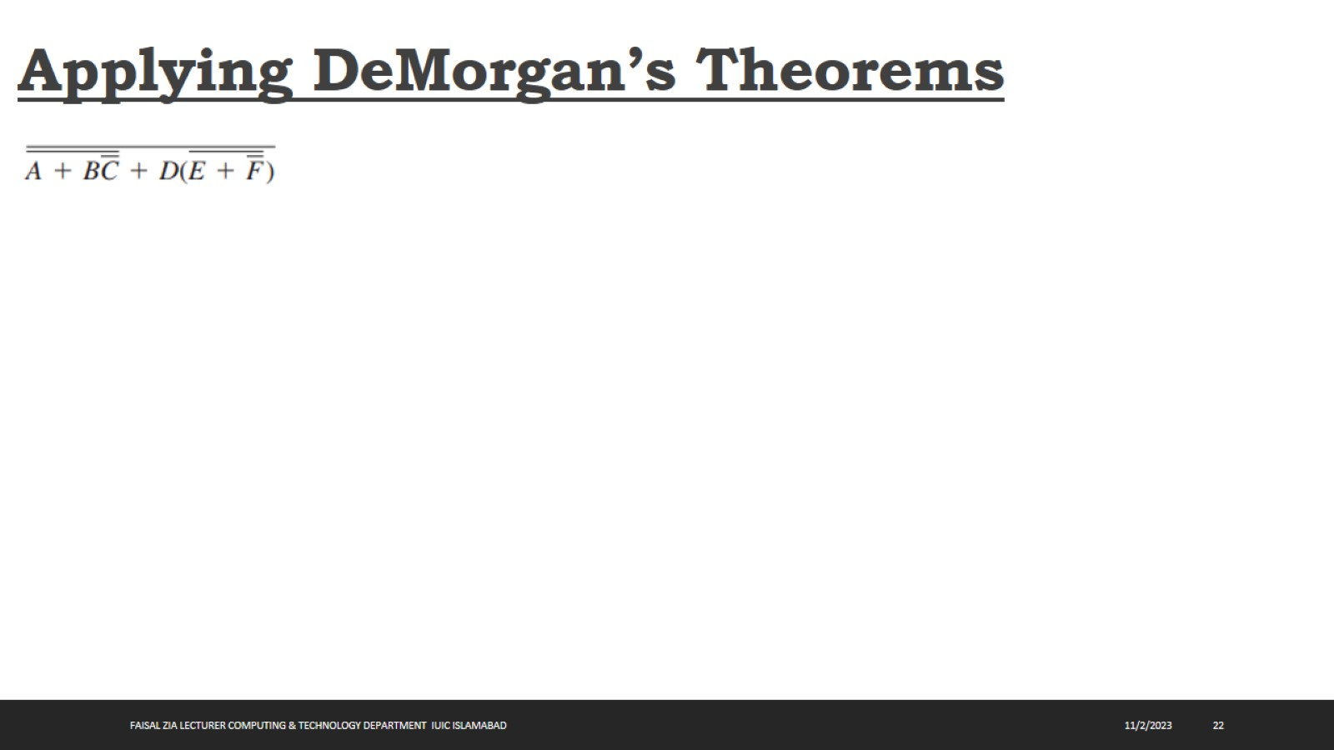
Applying DeMorgan’s Theorems

Slide 23
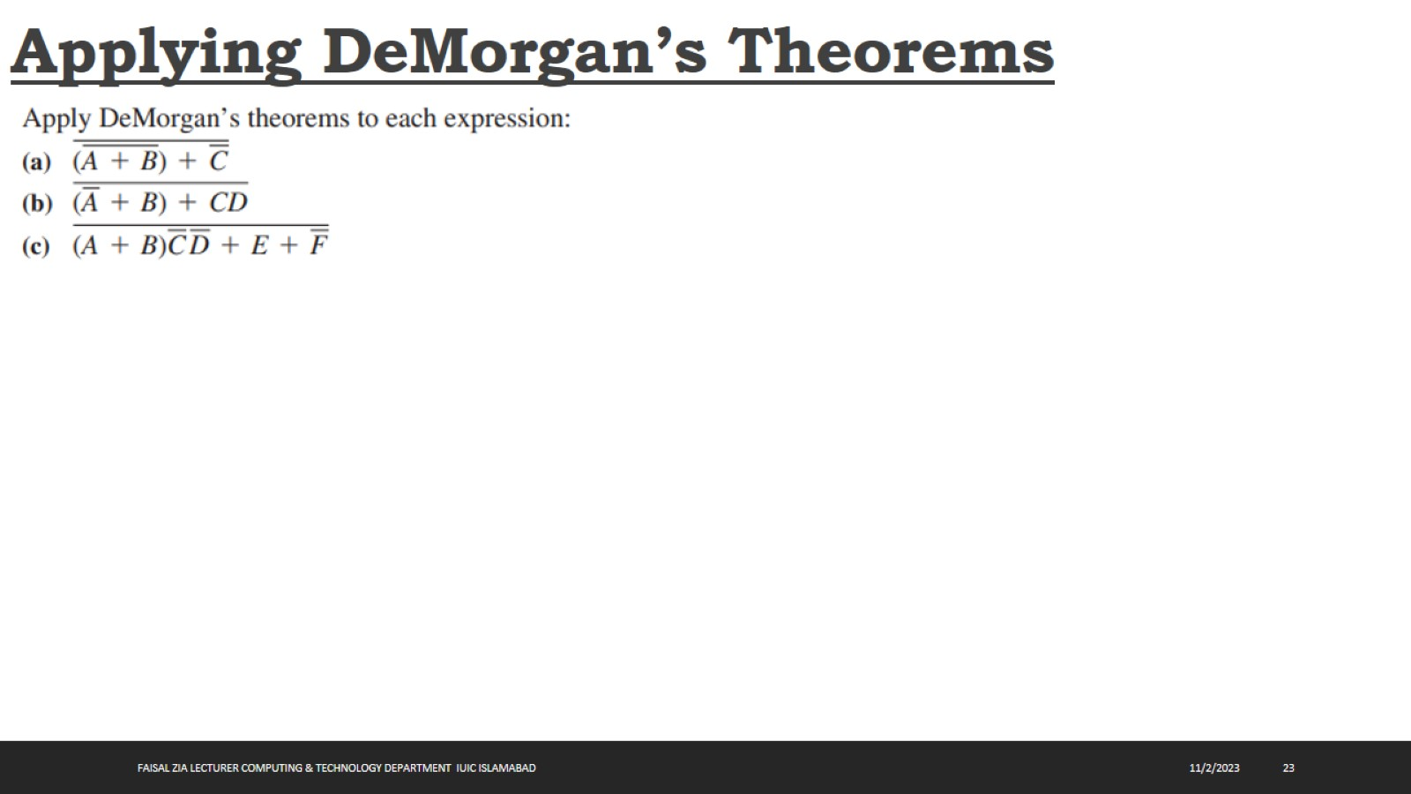
Applying DeMorgan’s Theorems

Slide 24
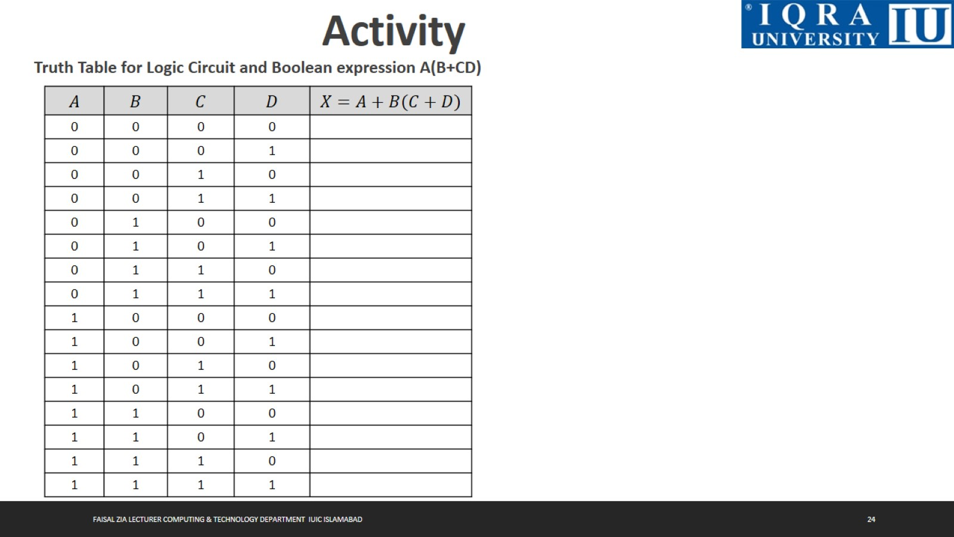
Activity

Slide 25
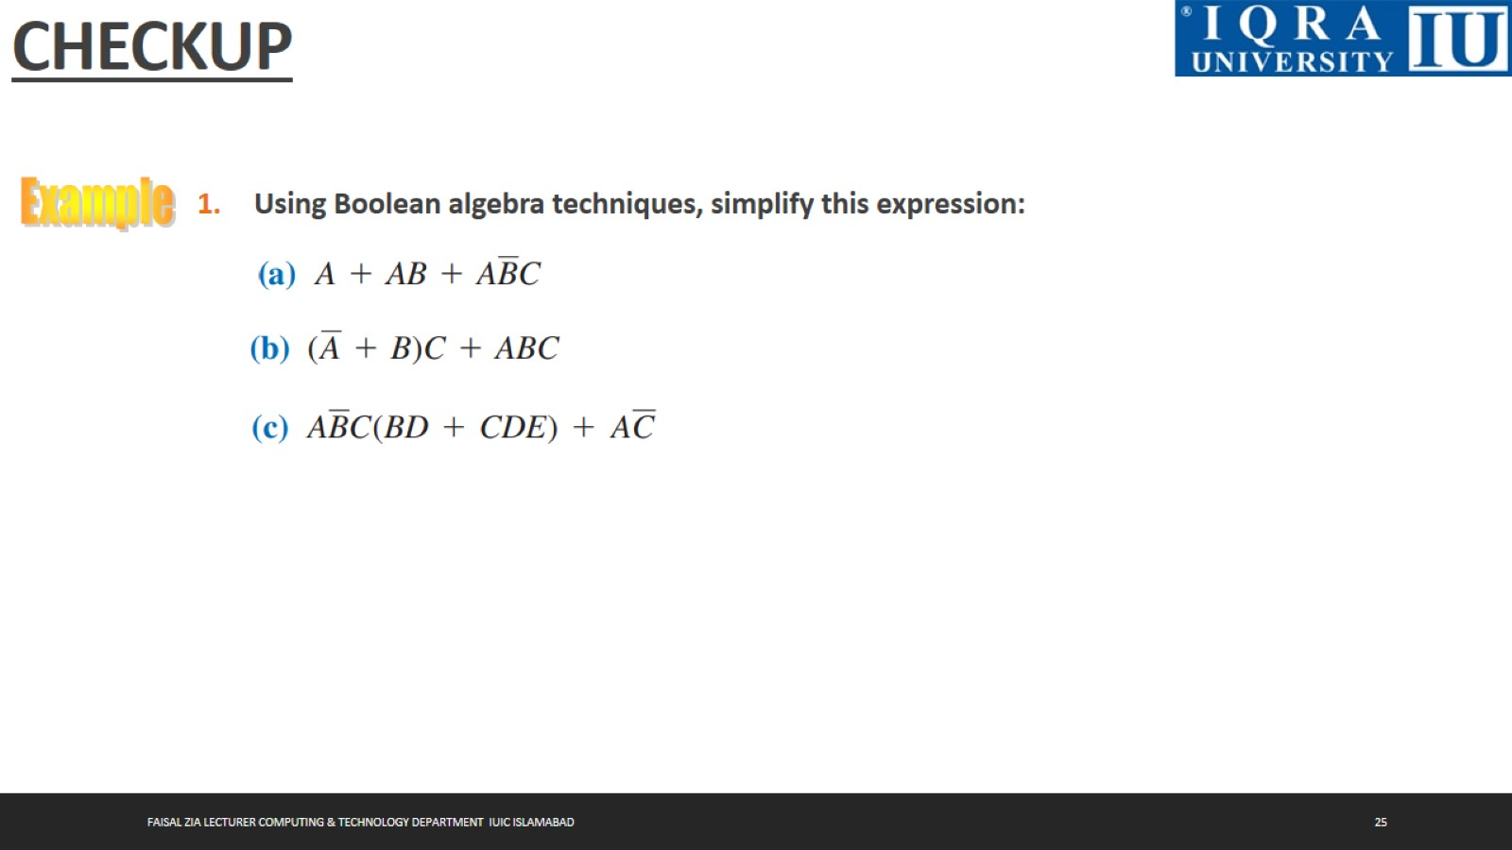
CHECKUP

Slide 26
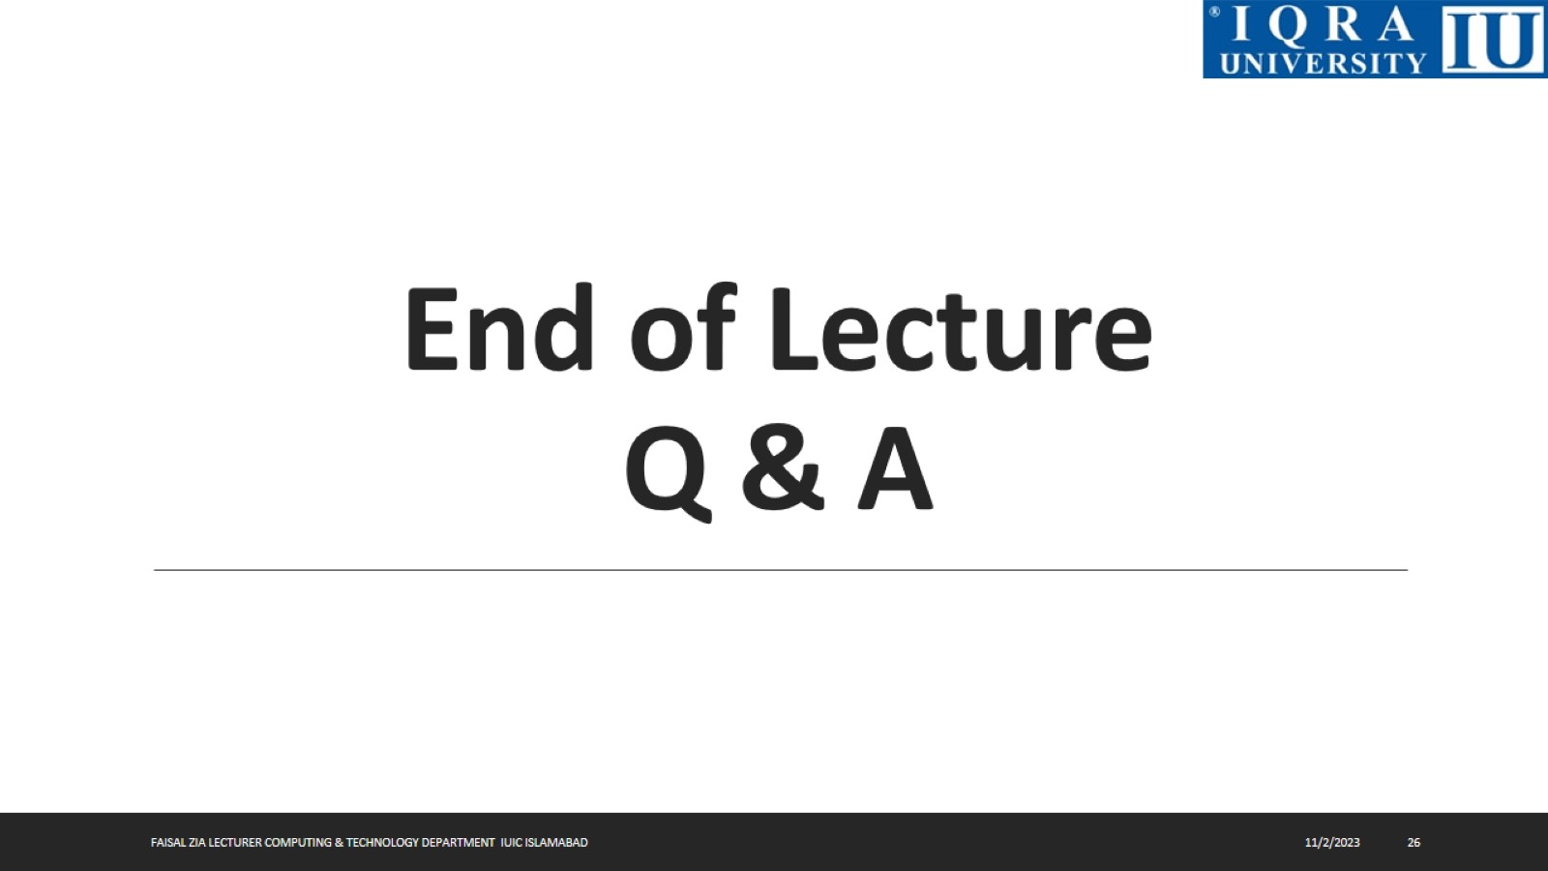
End of Lecture Q & A

